Slide 1
Module V Recommender Systems

Slide 2
Recommendation Systems
A recommendation system is a type of machine learning system that provides personalized recommendations to users based on their past behaviors, preferences, and patterns. It is a subclass of information filtering systems that use algorithms to recommend items to users based on their interests or behaviors.
A recommendation system is a data filtering engine that uses deep learning concepts and algorithms to suggest potential products depending on previous preferences or secondary filtering.
The concept behind such algorithms is finding patterns in a consumer or similar consumer behavior towards a service or product.
The method by which data is collected varies greatly depending on the type of products or services sold. For example, data collected on e-commerce websites would be in review ratings, while Youtube would save liked and disliked videos.

Slide 3
Recommendation Systems Lifecycle
Some recommendation systems are far more complex than others, but many follow a seven-step path to develop a successful recommendation model:
Collect the Data: Identify and collect data relevant to the recommendation system. For example, Amazon can collect reviews and product ratings (5-star rating system), while Netflix stores watched, like, and bookmarked shows and movies.
Store the Collected Data: Store data in proprietary data warehouses. Or utilize third-party cloud service providers such as Amazon, Google, MongoDB, etc. for greater efficiency and data retrieval speed.
Filter the Data: Filter problematic values (null, infinite, or misleading) in the dataset to improve model accuracy.
Analyze the Data: In the case of recommendation systems, analyzing data means feeding it into machine-learning or deep learning algorithms that can detect hidden insights and patterns.
Evaluating and Test Our Model: Check the performance of the recommendation system model. If the model performs poorly, tune the hyperparameters to the desired performance.
Deploy Our Model: Your model is ready to be deployed into actual practice. Continue to monitor and tune the system.
Online Machine Learning: Online machine learning after deployment can continuously improve and adjust the model by learning from newly acquired data, maintaining longevity.

Slide 4
Benefits of Using Recommendation Systems
Increased Sales: The number one reason why companies invest in such systems is to generate revenue. Increasing the sales through recommendation systems also increases consumer engagement on their site and captures longer session times.
Lower System Load: As the system does filter the most matching items for each given user, recommendation systems improve sales while maintaining a lower load on the system and decreasing costs in the long run.
Increasing Engagement and Satisfaction: By continuously providing consumers with an endless array of personalized products, consumers will continue to engage with the application/website. Recommendation Systems optimize the experience to reduce wasted page real estate to boost satisfaction with related content.

Slide 5
Real-Life Recommender System Example
Amazon- With millions of products on Amazon, consumers may get distracted by what they want to buy; an increase in product variety will result in increased consumer decision-making time. Amazon recommendation systems filter in likely items to help consumers find a satisfactory product.
Spotify- Spotify evaluates which songs its users enjoy listening to and will recommend new music accordingly. They also curate a Discover Weekly playlist for users to discover new yet familiar music. Spotify’s hybrid filtering algorithm helps listeners discover new music by learning their likes, dislikes, and nuances.
Facebook / Meta Facebook- also utilizes multiple recommendation systems throughout its app. These engines recommend the next post, friend suggestions, and ad placements based on likes, dislikes, mutual friends, and more. As with the previously stated companies, Facebook’s revenue is directly correlated to the effectiveness of its recommendation system.
Netflix- Netflix is known for its extensive use of recommendation systems. With over 80% of content watched on Netflix coming from algorithmic suggestions, their recommendation system generates an estimated 1 billion dollars of revenue per year. Furthermore, new Netflix accounts will rate popular shows and movies to help the recommendation algorithm predict new shows to avoid the cold start problem.
Google and Youtube- With one of the most popular search engines and browsers available, Google spends fortunes updating its recommender system efficiency and accuracy as much as possible.
In the search engine, Google will generate auto-fill results based on recent searches to help users find what they are looking for, increasing user satisfaction.
Google also deploys recommendation systems on Youtube by implementing personal suggestion and rating systems using filters like views, likes, shared videos, subscriptions, genres, and more. Youtube also utilizes popularity suggestions to generate views on highly trending videos.
Google advertising generates a large share of the revenue. Google stores behavioral data such as purchases, Youtube videos viewed, and searches made to provide and suggest advertisements that match products and services to the user.

Slide 6
Types of Recommendation System
There are basically two types of Recommendation System
Content-Based Filtering
Collaborative Based Filtering

Slide 7
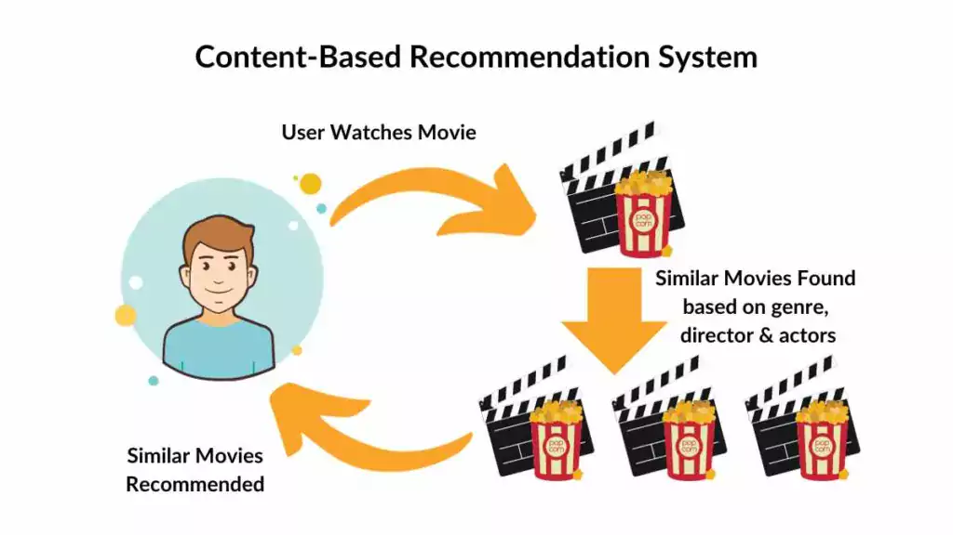
Content-Based Filtering
In this type of recommendation system, relevant items are shown using the content of the previously searched items by the users. Here content refers to the attribute/tag of the product that the user like.
In this type of system, products are tagged using certain keywords, then the system tries to understand what the user wants and it looks in its database and finally tries to recommend different products that the user wants.
In a movie recommendation system, each film is tagged with genres.
When a new user, User A, joins, the system initially suggests popular movies or gathers information through a user form. As User A rates movies over time, preferences emerge; for instance, if User A consistently rates action movies highly but rates anime movies poorly, the system recommends more action-oriented content.
However, this doesn’t imply a dislike for anime movies; further data collection is needed to refine recommendations accurately.

Slide 8
Content-Based Filtering
Advantage
Disadvantage
Model doesn’t need data of other users since recommendations are specific to a single user.
It makes it easier to scale to a large number of users.
The model can Capture the specific Interests of the user and can recommend items that very few other users are interested in.
Feature representation of items is hand-engineered to some extent, this tech requires a lot of domain knowledge.
The model can only make recommendations based on the existing interest of a user. In other words, the model has limited ability to expand on the user’s existing interests.

Slide 9
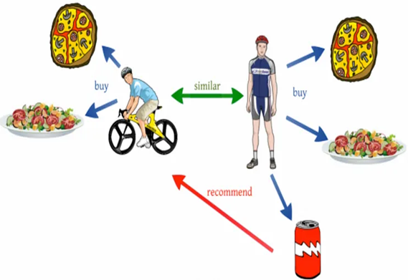
Collaborative Based Filtering
Recommending the new items to users based on the interest and preference of other similar users is basically collaborative-based filtering. For eg:- When we shop on Amazon it recommends new products saying “Customer who brought this also brought”.
This approach not only addresses the limitations of content-based filtering but also leverages user interactions, making it more robust. By focusing on the historical performance of users, this recommendation system can predict future preferences with greater accuracy.
There are 2 types of collaborative filtering:-
User-Based Collaborative Filtering
Item-Based Collaborative Filtering

Slide 10
User-Based Collaborative Filtering
User-based collaborative filtering recommends items to a user based on the preferences of similar users. The basic idea is that if two users have similar tastes or preferences in the past, they are likely to have similar tastes in the future as well.
Similarity Calculation: The system calculates the similarity between users based on their past interactions with items. This similarity is often computed using metrics like Pearson correlation, cosine similarity, or Jaccard similarity.
Neighborhood Selection: Once the similarity scores are calculated, the system selects a subset of users who are most similar to the target user. This subset is often referred to as the "neighborhood."
Recommendation Generation: Finally, the system recommends items to the target user based on the items liked or rated highly by users in the neighborhood but not yet interacted with by the target user.

Slide 11
Item-Based Collaborative Filtering
Item-based collaborative filtering recommends items to a user based on the similarity between items. The underlying assumption is that if a user likes or interacts with one item, they are likely to enjoy items similar to it.
Item Similarity Calculation: The system calculates the similarity between items based on how users have interacted with them in the past. Similarity metrics like cosine similarity or Pearson correlation are commonly used for this purpose.
Recommendation Generation: When a user interacts with an item, the system identifies similar items based on their similarity scores with the interacted item. It then recommends these similar items to the user.

Slide 12
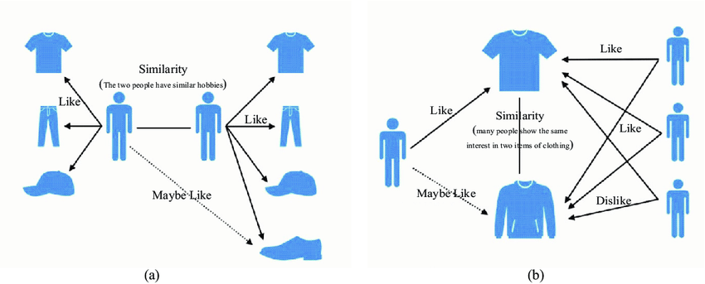
User Based Collaborative Filtering and Item Based Collaborative Filtering
(a) User Based Collaborative Filtering (b) Item Based Collaborative Filtering

Slide 13
Real World Example
User-Based Collaborative Filtering
Item-Based Collaborative Filtering
Netflix: Netflix utilizes user-based collaborative filtering to recommend movies and TV shows to its subscribers. When a user watches and rates movies or TV shows, Netflix compares their preferences to other users with similar tastes. If two users have watched and rated many of the same movies similarly, the system assumes they have similar tastes and recommends movies that one user has liked to the other user.
Amazon: Amazon uses collaborative filtering to recommend products to its customers. When a customer purchases a product, Amazon looks at other customers who have purchased the same or similar products and recommends other items they have bought to the current customer. For example, if a customer buys a camera, Amazon might recommend lenses or camera accessories that other customers have purchased along with that camera.
Pandora: Pandora, the music streaming service, employs item-based collaborative filtering to suggest songs to its users. Pandora analyzes the musical attributes of songs (such as genre, tempo, instrumentation) and creates a profile for each user based on the songs they have liked or disliked. Then, it recommends songs with similar musical attributes to those the user has liked in the past.
Spotify: Spotify also utilizes item-based collaborative filtering to recommend music tracks to its users. It analyzes the characteristics of songs, such as genre, tempo, mood, and instrumentation, and recommends similar songs based on the user's listening history. If a user frequently listens to rock music, Spotify may recommend other rock songs with similar attributes.
In both user-based and item-based collaborative filtering, the recommendations are based on similarities either between users or between items. These systems leverage the collective behavior of users to provide personalized recommendations, enhancing user experience and engagement.

Slide 14
Collaborative Filtering
Advantage
Disadvantage
It works well even if the data is small.
This model helps the users to discover a new interest in a given item but the model might still recommend it because similar users are interested in that item.
No need for Domain Knowledge
It cannot handle new items because the model doesn’t get trained on the newly added items in the database. This problem is known as Cold Start Problem.
Side Feature Doesn’t have much importance. Here Side features can be actor name or releasing year in the context of movie recommendation.

Slide 15
Singular value Decomposition–Based Recommenders
SVD is a matrix factorisation technique, which reduces the number of features of a dataset by reducing the space dimension from N-dimension to K-dimension (where K<N).
In the context of the recommender system, the SVD is used as a collaborative filtering technique.
It uses a matrix structure where each row represents a user, and each column represents an item.
The elements of this matrix are the ratings that are given to items by users.

Slide 16
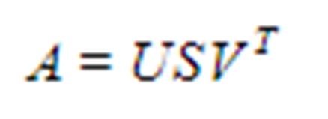
Singular value Decomposition–Based Recommenders
Matrix U: singular matrix of (user*latent factors)
Matrix S: diagonal matrix (shows the strength of each latent factor)
Matrix U: singular matrix of (item*latent factors)
The factorisation of this matrix is done by the singular value decomposition. It finds factors of matrices from the factorisation of a high-level (user-item-rating) matrix.
The singular value decomposition is a method of decomposing a matrix into three other matrices as given below:
where, A is a m x n utility matrix,
U is a m x r orthogonal left singular matrix, which represents the relationship between users and latent factors,
S is a r x r diagonal matrix, which describes the strength of each latent factor and
V is a r x n diagonal right singular matrix, which indicates the similarity between items and latent factors.
The latent factors here are the characteristics of the items, for example, the genre of the music. The SVD decreases the dimension of the utility matrix A by extracting its latent factors.
It maps each user and each item into a r-dimensional latent space.

Slide 17
Singular value Decomposition–Based Recommenders
Matrix Representation: In a recommendation system, user-item interactions are often represented as a matrix, where rows correspond to users, columns correspond to items, and the entries represent user-item interactions (e.g., ratings, clicks, purchases).
Matrix Factorization: SVD decomposes this interaction matrix into three matrices:
The user matrix: Represents users in terms of latent factors.
The item matrix: Represents items in terms of the same latent factors.
The diagonal matrix: Contains singular values, representing the strength of each latent factor.
Dimensionality Reduction: SVD retains only the top k singular values and their corresponding vectors, effectively reducing the dimensionality of the matrices. This reduces noise in the data and captures the most important patterns.
Recommendation Generation: To generate recommendations, the system reconstructs the original interaction matrix using the reduced-dimensional matrices obtained from SVD. This reconstructed matrix represents the predicted user-item interactions.
Top-N Recommendations: Once the reconstructed matrix is obtained, the system can recommend the top-N items to each user based on their predicted preferences. These recommendations are typically generated by selecting the items with the highest predicted ratings for each user.

Slide 18
Singular value Decomposition–Based Recommenders
Advantage
Disadvantage
Interpretability: The latent factors learned by SVD often correspond to meaningful characteristics of users and items, making the recommendations interpretable.
Efficiency: SVD can efficiently handle large-scale recommendation problems by reducing the dimensionality of the data.
Scalability: Despite being computationally intensive, SVD can be parallelized and optimized for scalability in distributed computing environments.
Cold Start Problem: SVD-based recommenders may struggle with cold-start scenarios, where there is limited or no historical data for new users or items.
Sparsity: In highly sparse matrices (i.e., when users have interacted with only a small fraction of items), SVD may suffer from overfitting and produce less accurate recommendations.

Slide 19
Customer Segmentation
Customer segmentation is the process of dividing customers into distinct groups based on shared characteristics or behaviors. This strategy allows businesses to better understand their customer base and tailor their products, services, and marketing efforts to meet the specific needs and preferences of each segment.
Not only do companies strive to divide their customers into measurable segments according to their needs, behaviors or demographics, but they also aim to determine the profit potential of each segment by analyzing its revenue and cost impacts.
Value-based segmentation evaluates groups of customers in terms of the revenue they generate and the costs of establishing and maintaining relationships with them. It also helps companies determine which segments are the most and least profitable so they can adjust their marketing budgets accordingly.
Customer segmentation can have a major effect on customer management because dividing customers into different groups that share similar needs enables the company to market to each group differently and focus on what each kind of customer needs at any given moment. Large or small, niche customer segments can be targeted depending on the company's resources or needs.
In business-to-business marketing, a company might segment customers based on a wide range of factors, including:
Industry
Number of employees
Products previously purchased from the company
Location
In business-to-consumer marketing, companies often segment customers according to demographics that include:
Age
Gender
Marital status
Location (urban, suburban, rural)
Life stage (single, married, divorced, empty-nester, retired, etc.)

Slide 20
Need of Customer Segmentation
Segmentation allows marketers to better tailor their marketing efforts to various audience subsets. Those efforts can relate to both communications and product development. Specifically, segmentation helps a company:
Create and communicate targeted marketing messages that will resonate with specific groups of customers, but not with others (who will receive messages tailored to their needs and interests instead)
Select the best communication channel for the segment, which might be email, social media posts, radio advertising, or another approach, depending on the segment
Identify ways to improve products or new product or service opportunities
Establish better customer relationships
Test pricing options
Focus on the most profitable customers
Improve customer service
Upsell and cross-sell other products and services

Slide 21
Benefits of customer segmentation
Efficient use of marketing resources. By enabling companies to target groups of customers, a customer segmentation model provides for the effective allocation of marketing resources and the maximization of cross- and up-selling opportunities.
More accurate deal offerings. When customers groups are sent personalized messages as part of a marketing mix that's designed around their needs, it's easier for companies to send those customers special offers meant to encourage them to buy more products.
Improved customer loyalty and retention. Customer service, loyalty and retention are improved as a byproduct of customer segmentation's personalized nature. For example, marketing materials sent out using customer segmentation tend to be more valued and appreciated by customers who receive them, as opposed to impersonal brand messaging that doesn't acknowledge purchase history or any kind of customer relationship.
Competition. Customer segmentation also enables a business to stay a step ahead of competitors in specific sections of the market by identifying new or existing products that potential customers could be interested in or by improving products to meet customer expectations.

Slide 22
Customer Segmentation Contribution in Personalized Recommendations
Understanding Diverse Customer Groups: Customer segmentation helps divide the user base into distinct groups based on shared characteristics such as demographics, behavior, preferences, and purchasing patterns. By understanding these segments, recommendation systems can tailor recommendations to better meet the specific needs and preferences of each group.
Targeted Content Recommendations: Once customer segments are identified, recommendation systems can deliver targeted content recommendations to each segment. For example, different segments may have varying preferences for products, services, or content. By segmenting customers, the system can recommend items that are most relevant and appealing to each segment, thereby improving user satisfaction and engagement.
Personalization at Scale: Segmentation allows recommendation systems to personalize recommendations at scale by applying similar recommendations to users within the same segment. Instead of treating each user as unique, the system can leverage insights gained from segment analysis to make more accurate and efficient recommendations to a large user base.
Improved Recommendation Accuracy: Segment-specific recommendation models can be trained to capture the unique preferences and behaviors of each segment. These models can incorporate segment-specific features and patterns to generate more accurate recommendations tailored to the characteristics of each segment, leading to higher relevance and effectiveness of recommendations.
Adapting to Changes Over Time: Customer segments are not static and may evolve over time due to changes in preferences, trends, or market conditions. Recommendation systems can continuously analyze customer behavior and adapt segmentation models to reflect these changes, ensuring that recommendations remain relevant and up-to-date.
Enhanced Customer Engagement and Loyalty: By delivering personalized recommendations that resonate with each customer segment, recommendation systems can increase user engagement, drive repeat purchases, and foster customer loyalty. Customers are more likely to engage with a platform or service that understands their needs and preferences and delivers relevant recommendations accordingly.

Slide 23
Social Network Analysis
Social Network Analysis (SNA) is a powerful methodological approach that examines the relationships and connections between individuals, groups, or entities within a social system. It delves into the structure, patterns, and dynamics of these connections, offering insights into how information flows, how influence is exerted, and how communities or networks function.
Core Components of Social Network Analysis
Nodes and Edges: Networks consist of nodes (also known as vertices or actors) representing individuals or entities, and edges (also called ties or links) representing the relationships or interactions between these nodes. These connections can be friendships, collaborations, interactions, transactions, or any other type of relationship.
Network Metrics and Measures: SNA employs various metrics to analyze networks. Degree centrality measures the number of connections a node has, while betweenness centrality assesses a node's importance in connecting different parts of the network. Other measures include closeness centrality, clustering coefficients, and network density, all providing different insights into the structure and dynamics of the network.
Network Visualization: Visual representations of networks through graphs or diagrams help in understanding complex relationships. Nodes are depicted as points, and edges as lines or arcs connecting them, allowing for a clear visualization of connections and patterns within the network.

Slide 24
Social Networking Analysis
Social network analysis (SNA) is a field of study that examines social structures through the use of network and graph theory. It focuses on analyzing the relationships and interactions between individuals, groups, or organizations within a social network. Here's an overview of social network analysis:
Network Representation: In social network analysis, social structures are represented as networks, which consist of nodes (representing entities such as individuals, organizations, or concepts) and edges (representing relationships or interactions between nodes). These networks can be visualized as graphs, with nodes as points and edges as lines connecting them.
Node Attributes: Nodes in a social network may have attributes or characteristics associated with them, such as demographics, interests, or behaviors. Analyzing these attributes alongside network structure can provide insights into the roles and behaviors of individuals within the network.
Edge Attributes: Similarly, edges in a social network may have attributes, such as the strength or type of relationship between nodes. Analyzing these edge attributes can reveal patterns of interaction and influence within the network.
Centrality Measures: Centrality measures quantify the importance or prominence of nodes within a network. Common centrality measures include degree centrality (the number of connections a node has), betweenness centrality (the extent to which a node lies on the shortest paths between other nodes), and closeness centrality (the average distance of a node to all other nodes).
Community Detection: Community detection algorithms identify groups or clusters of nodes within a network that are densely connected internally but sparsely connected to nodes in other groups. These communities represent cohesive subgroups within the larger network and can provide insights into social structures and dynamics.
Influence and Diffusion: Social network analysis can also explore the spread of information, behaviors, or influence within a network. This includes studying processes such as information diffusion, opinion formation, and the adoption of innovations or behaviors through social influence mechanisms.
Applications: Social network analysis has diverse applications across various domains, including sociology, anthropology, psychology, marketing, epidemiology, and organizational studies. It is used to study social relationships, organizational structures, information flow, collaboration networks, and the dynamics of online communities and social media platforms.

Slide 25
Social Networking Analysis
Ego Network Analysis
Complete Network Analysis
Ego network Analysis is the one that finds the relationship among people. The analysis is done for a particular sample of people chosen from the whole population. This sampling is done randomly to analyze the relationship. The attributes involved in this ego network analysis are a person’s size, diversity, etc.
This analysis is done by traditional surveys. The surveys involve that they people are asked with whom they interact with and their name of the relationship between them. It is not focused to find the relationship between everyone in the sample. It is an effort to find the density of the network in those samples. This hypothesis is tested using some statistical hypothesis testing techniques.
The following functions are served by Ego Networks:
Propagation of information efficiently.
Sensemaking from links, For example, Social links, relationships.
Access to resources, efficient connection path generation.
Community detection, identification of the formation of groups.
Analysis of the ties among individuals for social support.
Complete network analysis is the analysis that is used in all network analyses. It analyses the relationship among the sample of people chosen from the large population. Subgroup analysis, centrality measure, and equivalence analysis are based on the complete network analysis. This analysis measure helps the organization or the company to make any decision with the help of their relationship. Testing the sample will show the relationship in the whole network since the sample is taken from a single set of domains.

Slide 26
Applications of Social Network Analysis
Social Sciences: SNA is extensively used in sociology, anthropology, and psychology to study social structures, influence, information flow, and social behavior within communities or societies.
Business and Organizational Studies: In the corporate world, SNA is applied to analyze organizational structures, communication patterns, team dynamics, and knowledge sharing within companies. It helps identify key influencers, streamline workflows, and enhance collaboration.
Healthcare: SNA plays a crucial role in healthcare by analyzing patient-provider networks, disease spread, healthcare collaborations, and information flow within healthcare systems. It assists in identifying influential healthcare providers and understanding how information or diseases disseminate within populations.
Online Social Networks: With the rise of digital platforms, SNA is essential for understanding interactions, user behavior, community formation, and information diffusion on platforms like Facebook, Twitter, LinkedIn, and more.

Slide 27
Challenges and Future Trends
Data Collection and Quality: Collecting comprehensive and reliable network data can be challenging, especially in large-scale networks. Ethical considerations regarding privacy and consent also need to be addressed.
Complexity and Interpretation: Analyzing complex networks and deriving meaningful insights can be challenging. Understanding causality and the dynamics of relationships requires advanced analysis techniques.
Future Trends: The future of SNA involves leveraging advancements in technology, big data analytics, and machine learning to handle larger datasets, perform predictive modeling, and gain deeper insights into network behaviors. Integrating SNA with other disciplines like AI and natural language processing will unlock new possibilities in understanding and utilizing social networks.
Shradha Dubey
Assistant Professor

